Slide 1
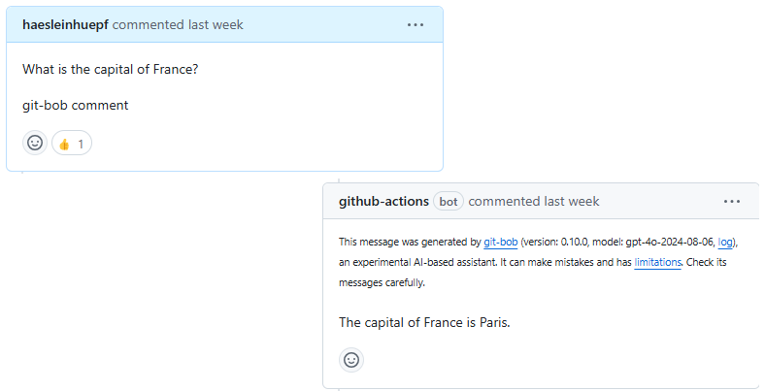
Towards Transparency and Knowledge Exchange in AI-assisted Data Analysis Code Generation
Robert Haase
Leipzig University, ScaDS.AI, NFDI4BioImage

Slide 2
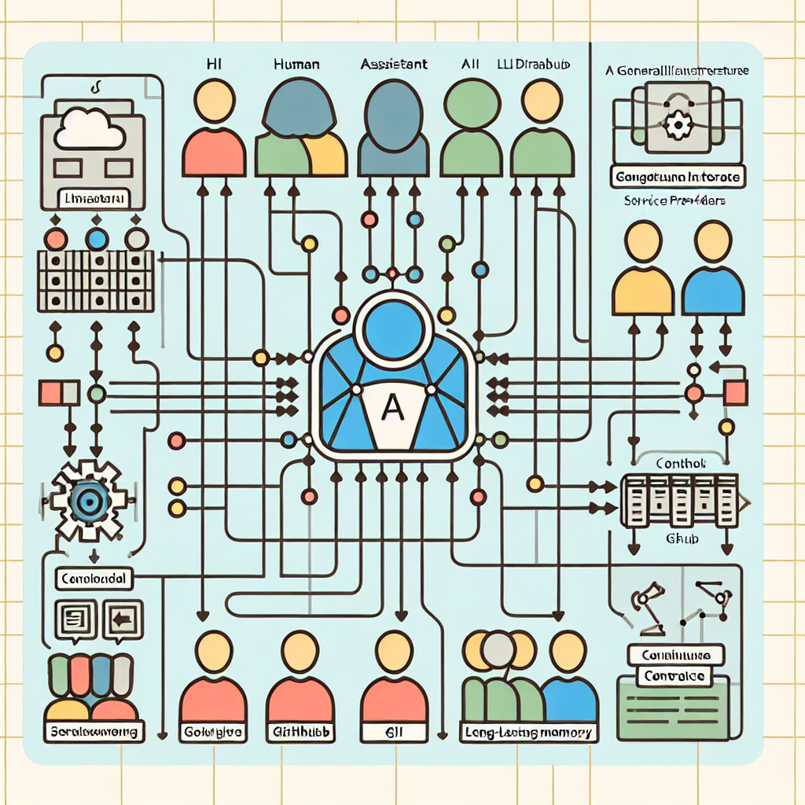
The Challenge
• LLMs are changing data science and scientific research
• Generated code and prompts are often not preserved
• Lack of professional peer-review system for AI-generated content
• Limited transparency in AI-human collaboration

Slide 3
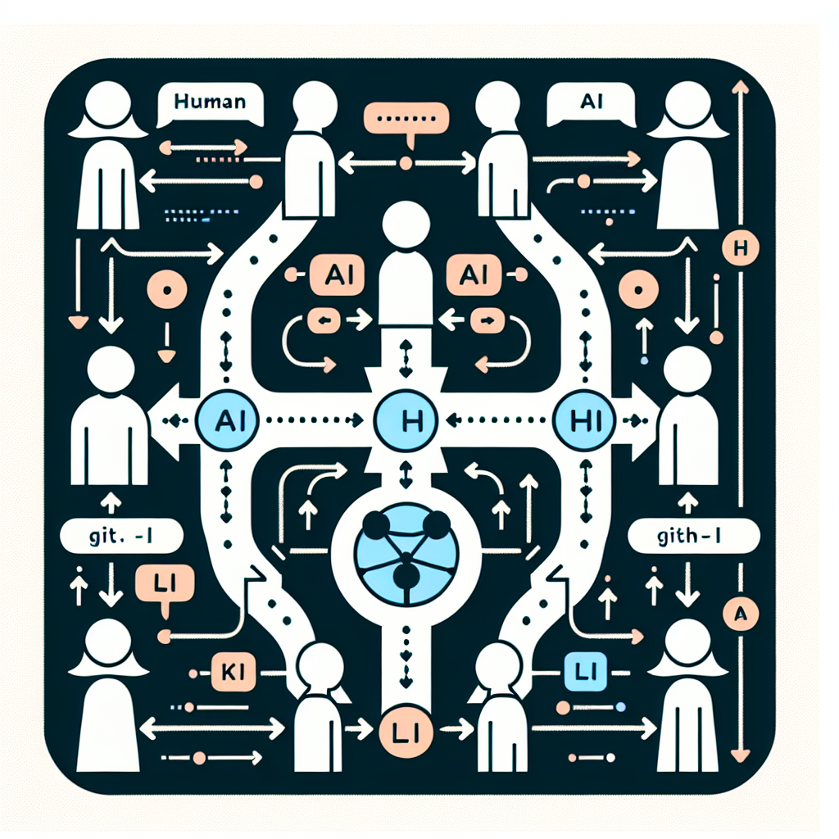
Introducing git-bob
• AI-assistant embedded in GitHub/GitLab platform
• Enables transparent interaction between humans and AI
• Preserves complete discussion threads
• Open-source implementation

Slide 4
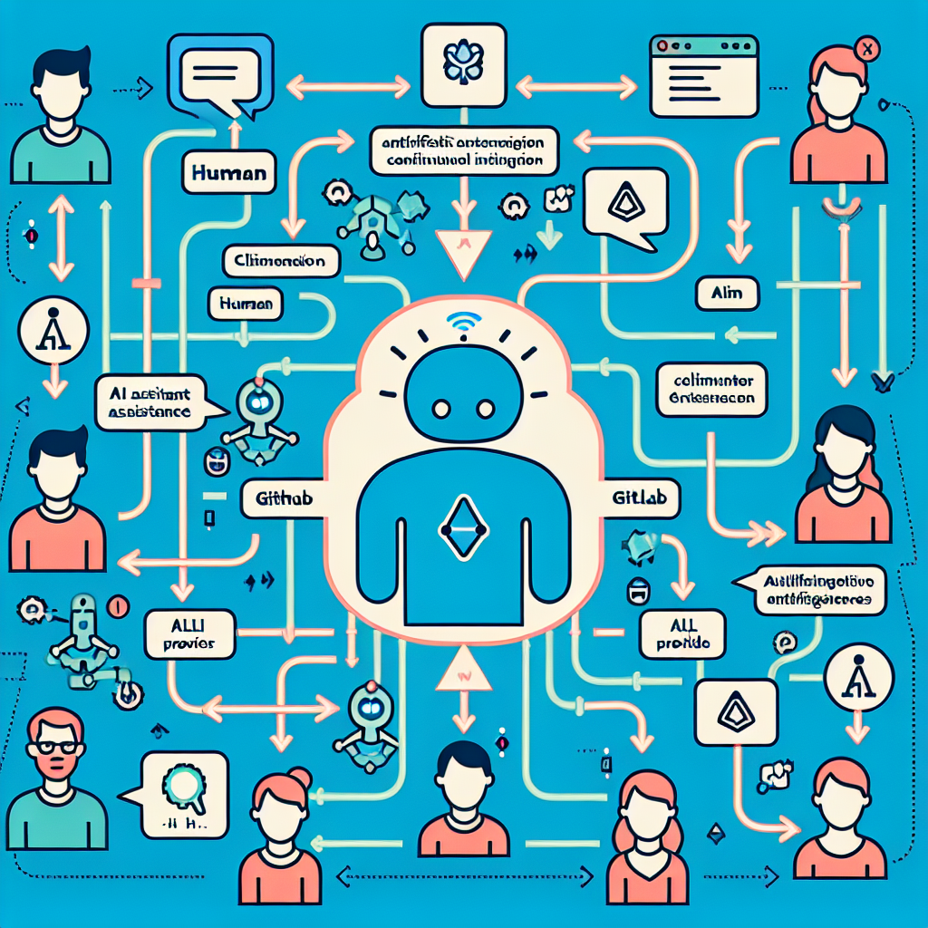
Key Features
• Multiple humans can interact in one thread
• All discussions and code modifications are preserved
• Compatible with various LLMs (GPT4, Claude, Gemini)
• Runs in GitHub/GitLab infrastructure

Slide 5
Common Tasks
Git-bob can assist with:
• Data analysis and visualization tasks
• Code documentation
• Library support and user assistance
• Data analysis in repositories
• Scientific manuscript writing

Slide 6
Workflow Example
1. Domain expert opens an issue
2. Repository member triggers git-bob
3. AI generates solution with code/visualizations
4. Humans and AI discuss iteratively
5. Solution implemented via pull request
6. Human review and merge

Slide 7
Technical Details
• No local installation required
• Runs as GitHub workflow/GitLab pipeline
• Public repos: 4 CPU cores, 16GB RAM
• Private repos: 2 CPU cores, 7GB RAM
• Customizable on institutional GitLab servers

Slide 8
Limitations
• Dependent on LLM capabilities (~50% success rate)
• Token length limitations
• Hardware constraints in free tier
• Sensitive data should not be submitted

Slide 9
Impact on Scientific Practice
• Promotes transparency in AI-assisted research
• Enables collaborative knowledge exchange
• Documents AI-human interactions
• Supports good scientific practice

Slide 10
Get Started
Repository: github.com/haesleinhuepf/git-bob
Implement transparency in your AI-assisted research today!

